Slide 1
IPFS Weekly Call May 13th
Jiale’s Persontation For IPFS Community
About IPFS Developers Development in China

Slide 2
1 . Let Me Introduce Myself

Slide 3



Contact
https://twitter.com/daijiale6239
Name : Jiale Dai
Age：24
Graduate from ： University of electronic science and technology of China（UESTC）
Before: A senior back-end software engineer from Baidu.inc
Now：Focus on fintech and edge computing solution for bussiness
：
：

Slide 4
2 . How Is My Life Meet With IPFS

Slide 5
3 . IPFS Developers Meetup in China

Slide 6
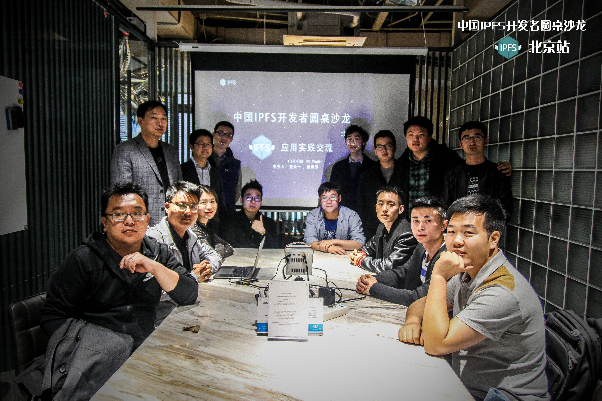
IPFS Chinese Developers Meet Up 1st
Place：a coffee shop at ZOL in Beijing
Date : 2018.4
Attendance：15 people
Topic1 ：How to use Ngrok to build IPFS Gateway
Topic2 ： What’s reference about IPFS for ontology blockchain？
Topic3 ：If ipfs can enter Chinese CDN Market？

Slide 7
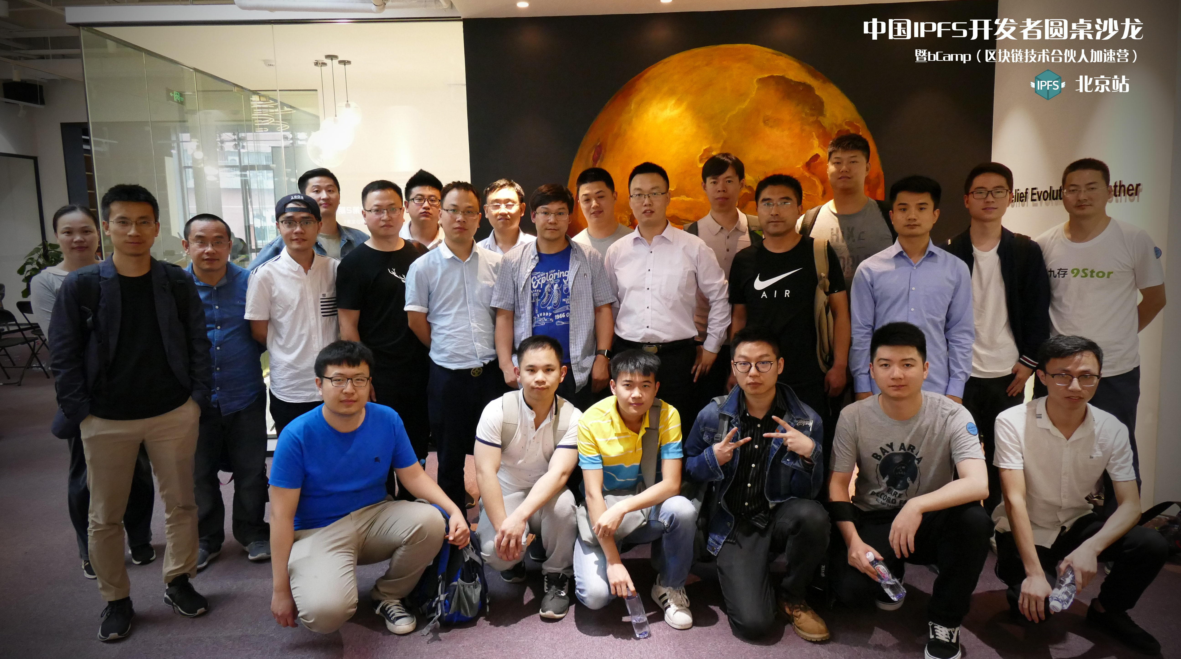
IPFS Chinese Developers Meet Up 2nd
Place：At bCamp in Beijing
Date : 2018.5
Attendance：50+ people
Topic1 ： Use re-encrytion to protect your data in IPFS Network
Topic2 ： The Architecture Of IPFS
Topic3 ： Why eos also need a dsn like ipfs
Topic4 ： The gateway base on service worker

Slide 8
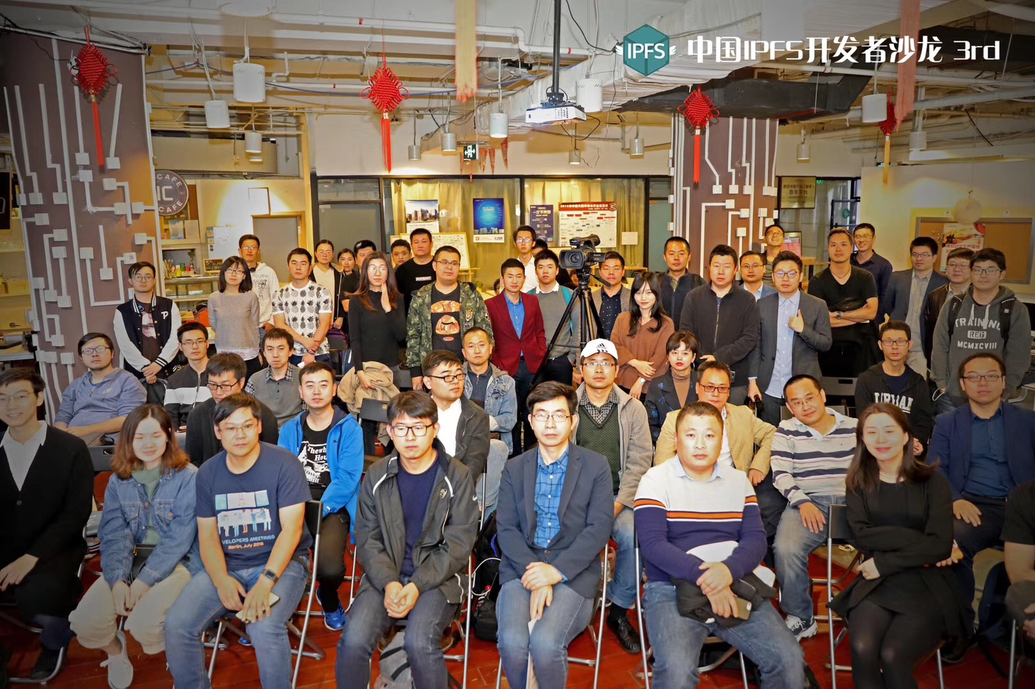
IPFS Chinese Developers Meet Up 3rd
Place：A business incubator at ZOL in Beijing
Date : 2018.8
Attendance：100+ people
Topic1 ： If IPFS can be combined with Solid
Topic2 ： What’s the libp2p and how it works
Topic3 ： What’s the Filecoin and what it built for

Slide 9
4 . Some Of Other Chinese Contributions To IPFS Community

Slide 10

Education
Sermon
Community
Co-Organization
Open Source
Code Or Solution
Contributions
Community Co-Organization
Enthusiasts、miners、developers、investors、users
Education Sermon
Technical training teachers and bloggers
Open Source Code Or Solution Contributions
Technology companies and
independent developers

Slide 11
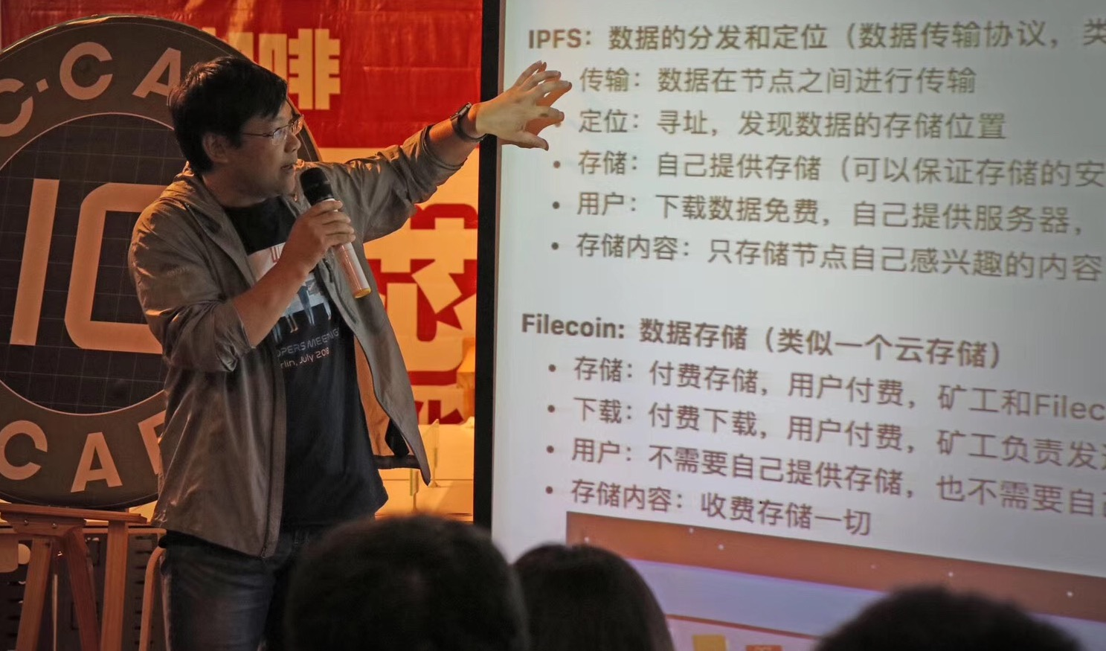
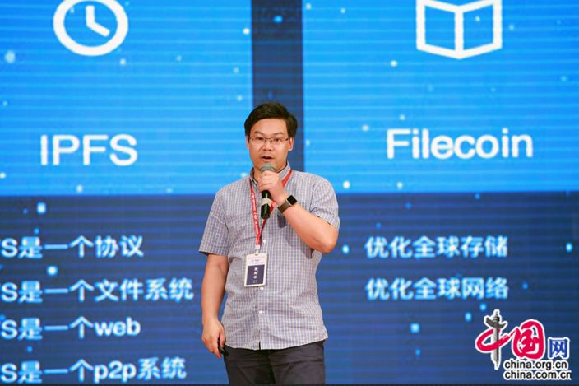
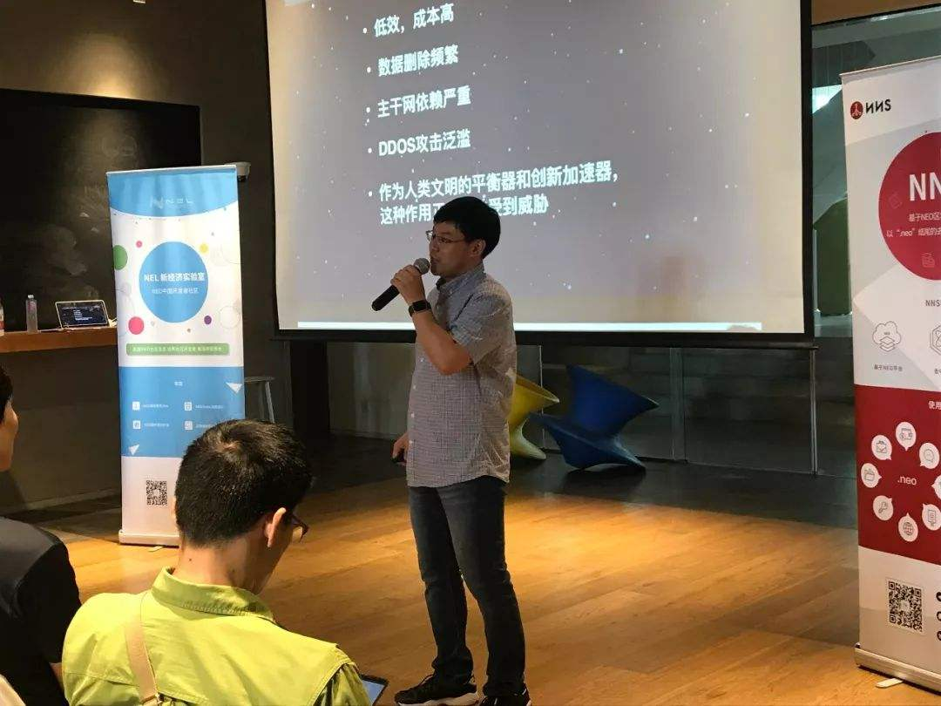
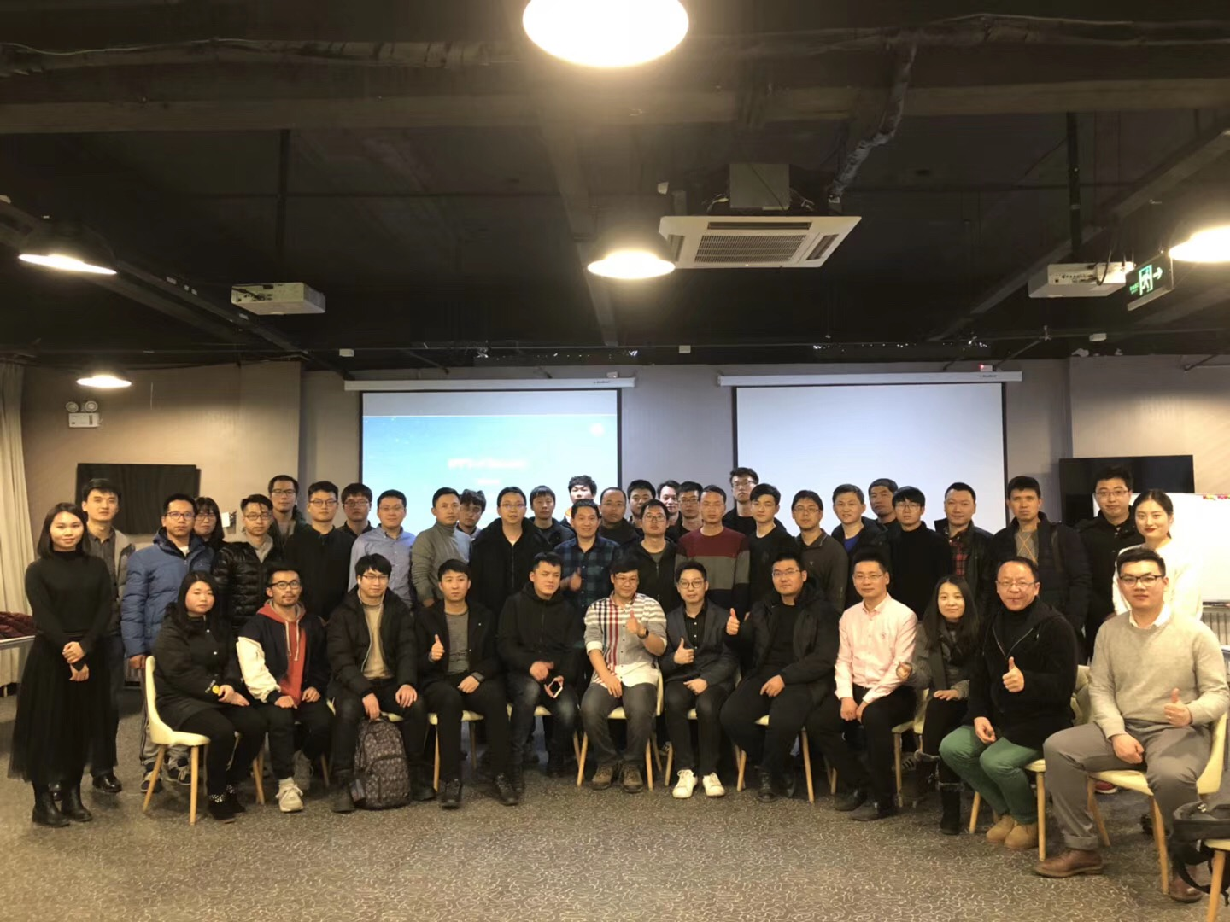
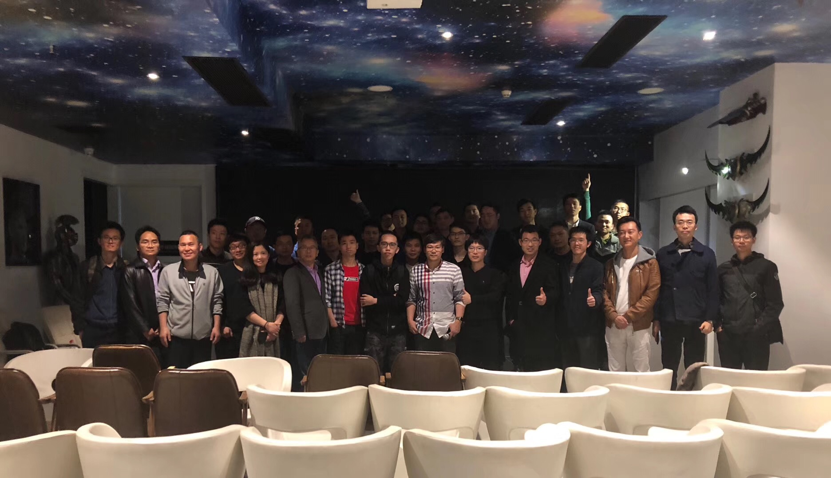
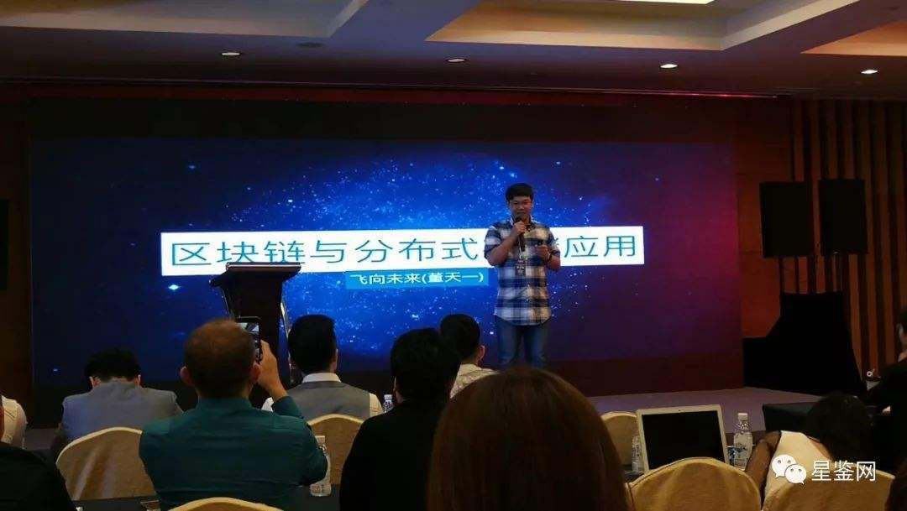
Community Co-Organization
Thanks to Tianyi Dong’s tour speeches last year

Slide 12
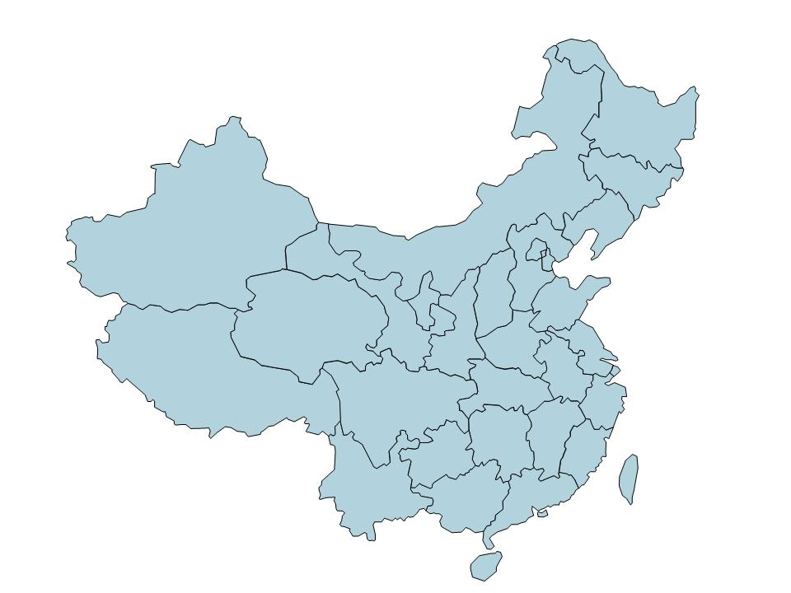
Community Co-Organization
More and more community Co-Organization
camp out at different city all over china.
Beijing
Hangzhou
Shanghai
Fuzhou
Chengdu
Shenzhen
HK

Slide 13
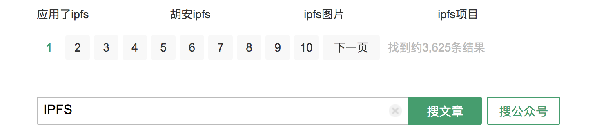
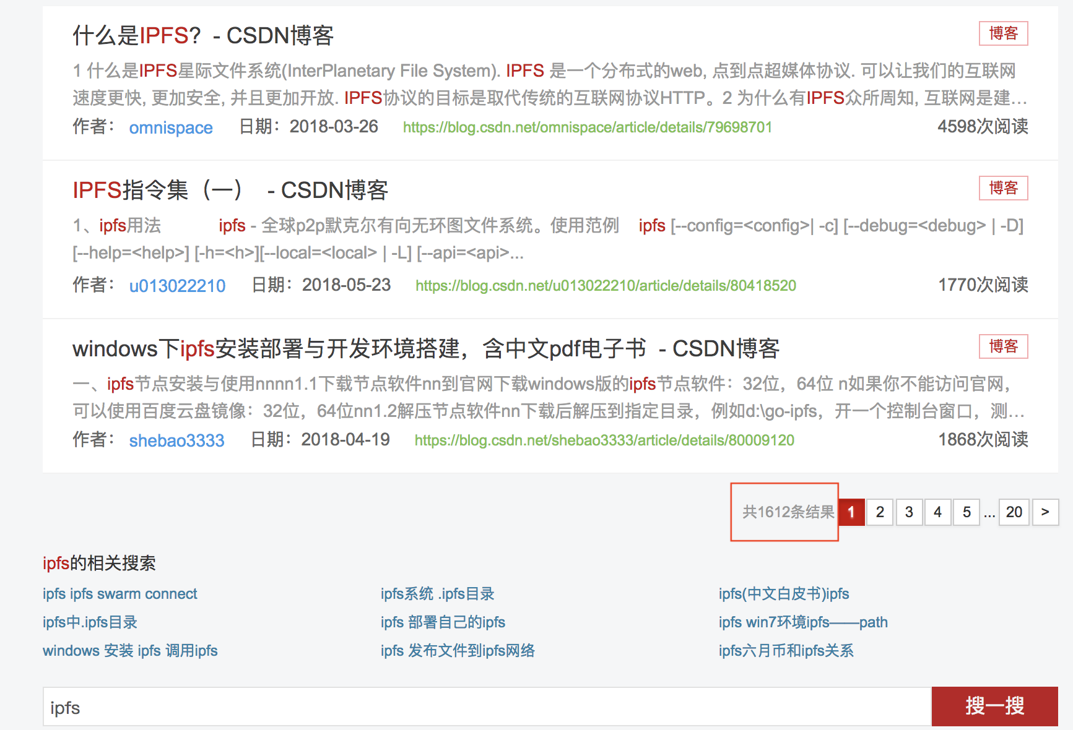
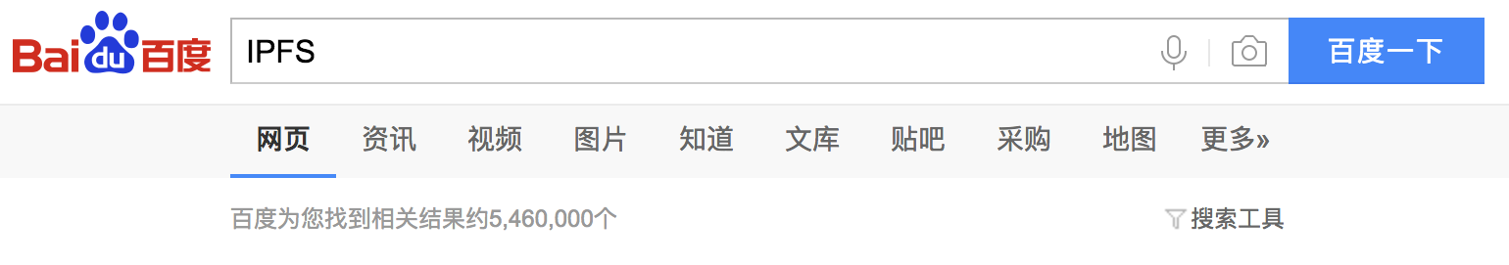
Education Sermon
Today there are thousands of IPFS blogs made by hundreds of
chinese Bloggers all over the chinese main network medias
Like wechat\baidu\csdn …
These blogs have been read by morn than
tens of thousands of chinese people

Slide 14
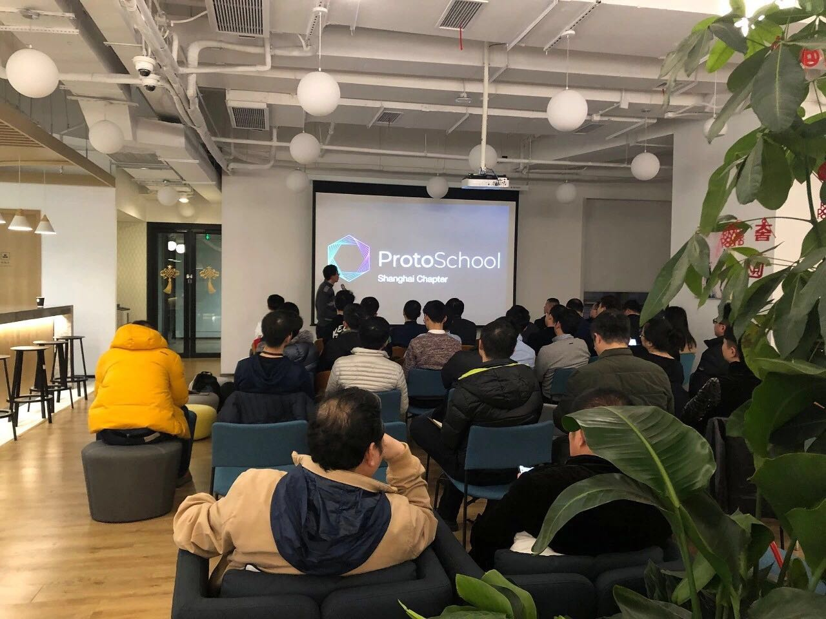
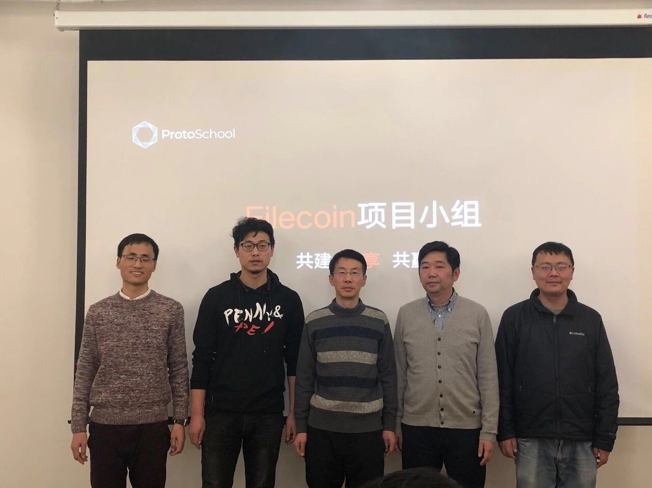
Education Sermon
The First Meetup of ProtoSchool in Shanghai
Date：2019.2.26
Attendance ：67+ people
Filecoin study group have been set up by IPFS-Force community and LD Research

Slide 15
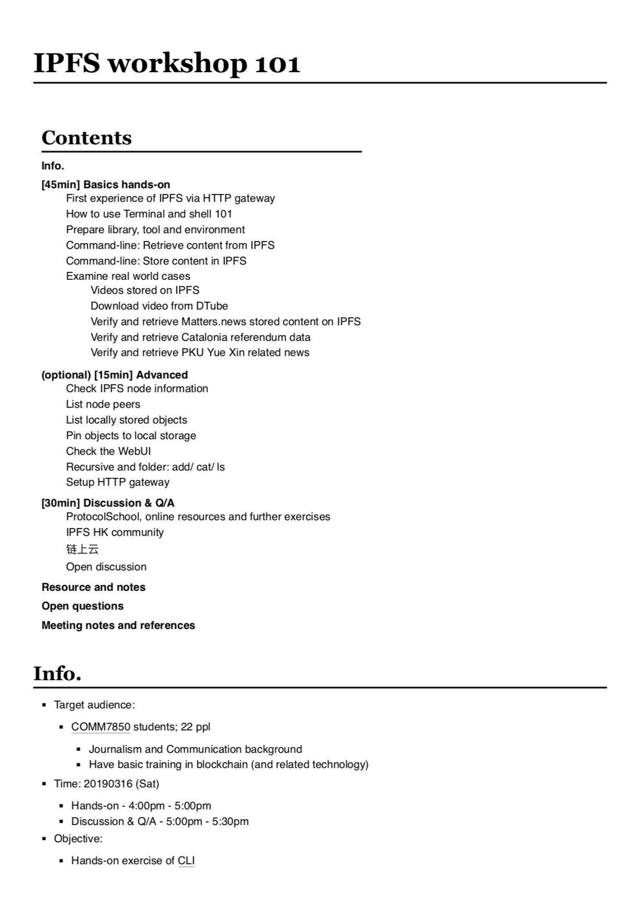
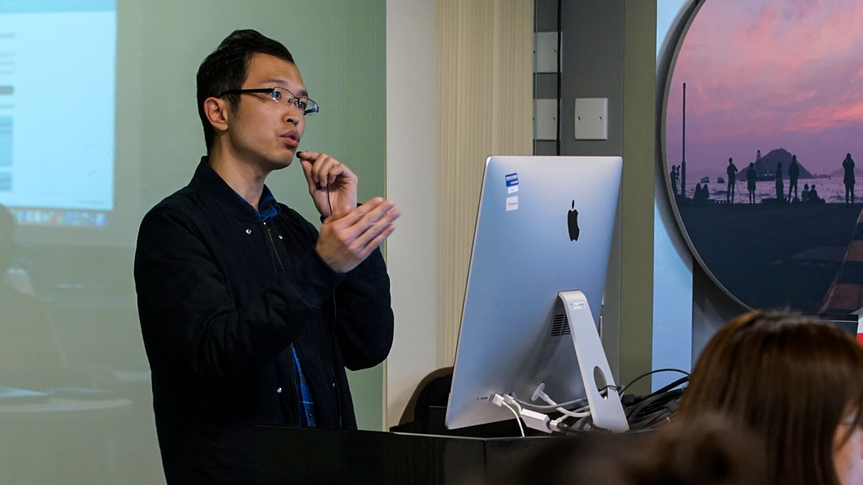
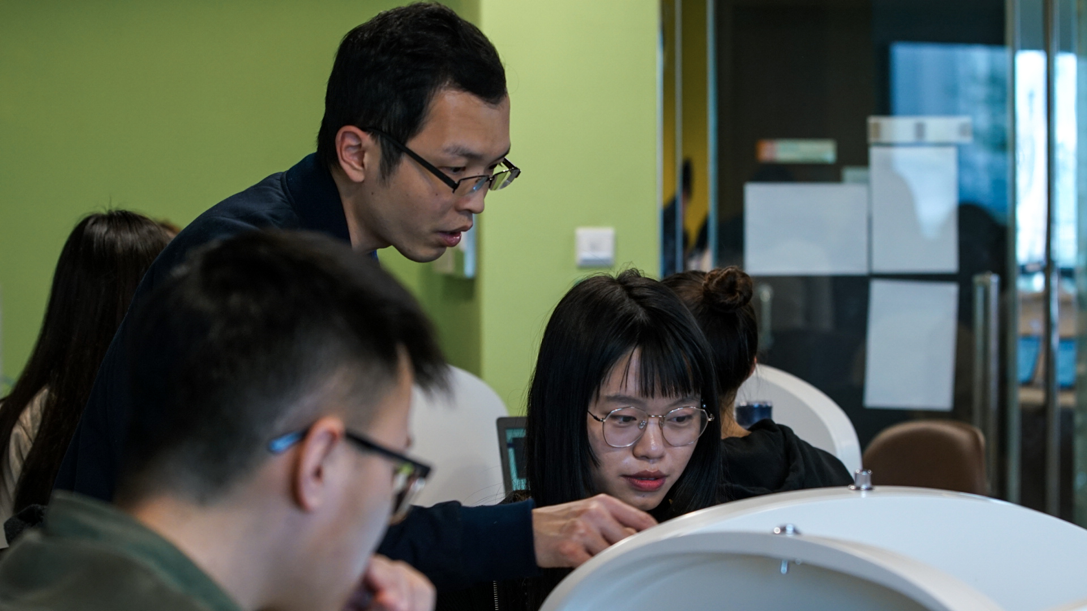

Education Sermon
Thanks to Kevin Wang :
IPFS workshop 101
firstly launched at
Hong Kong Baptist University

Slide 16
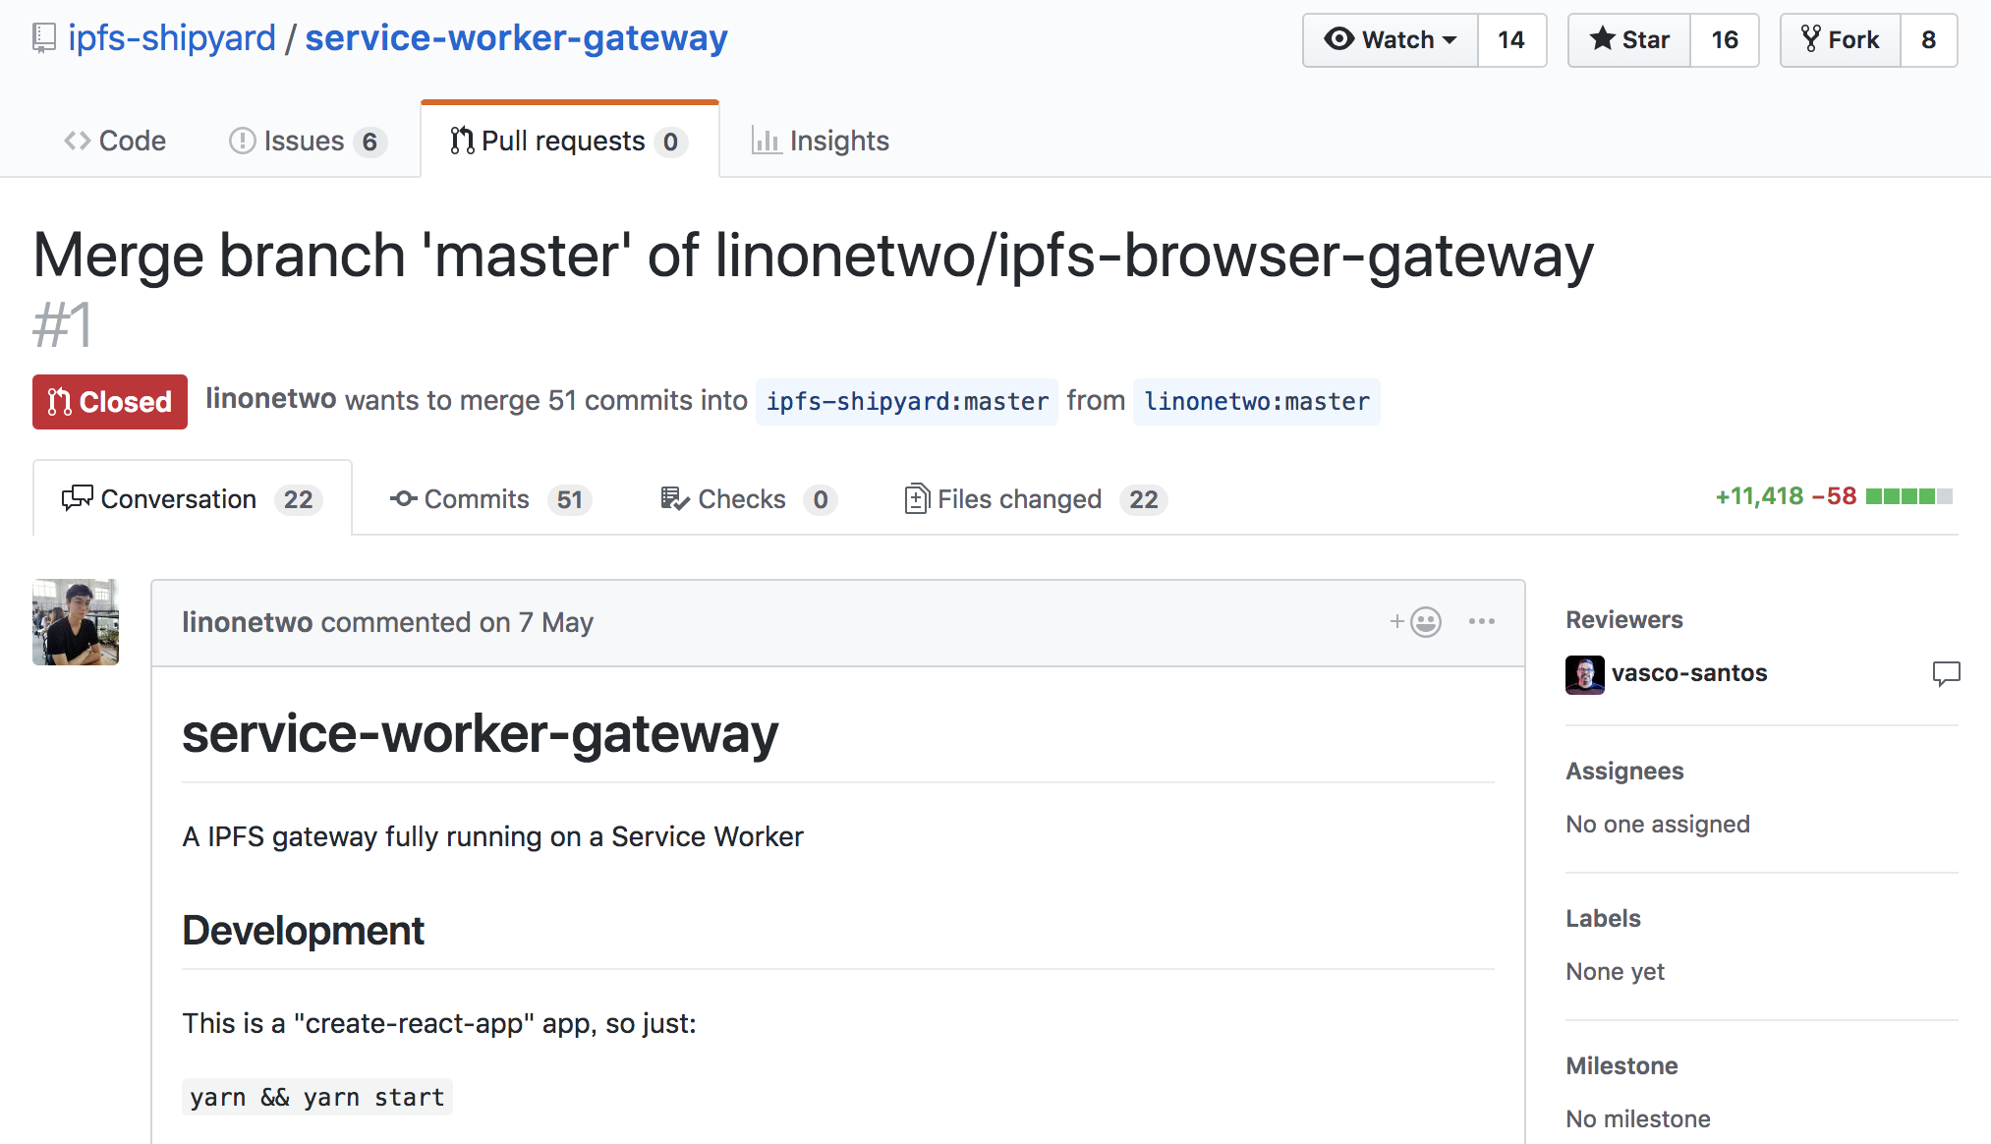
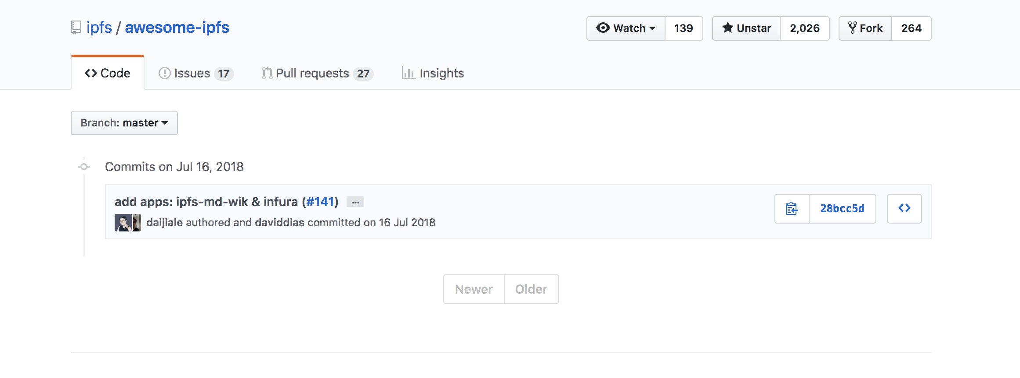
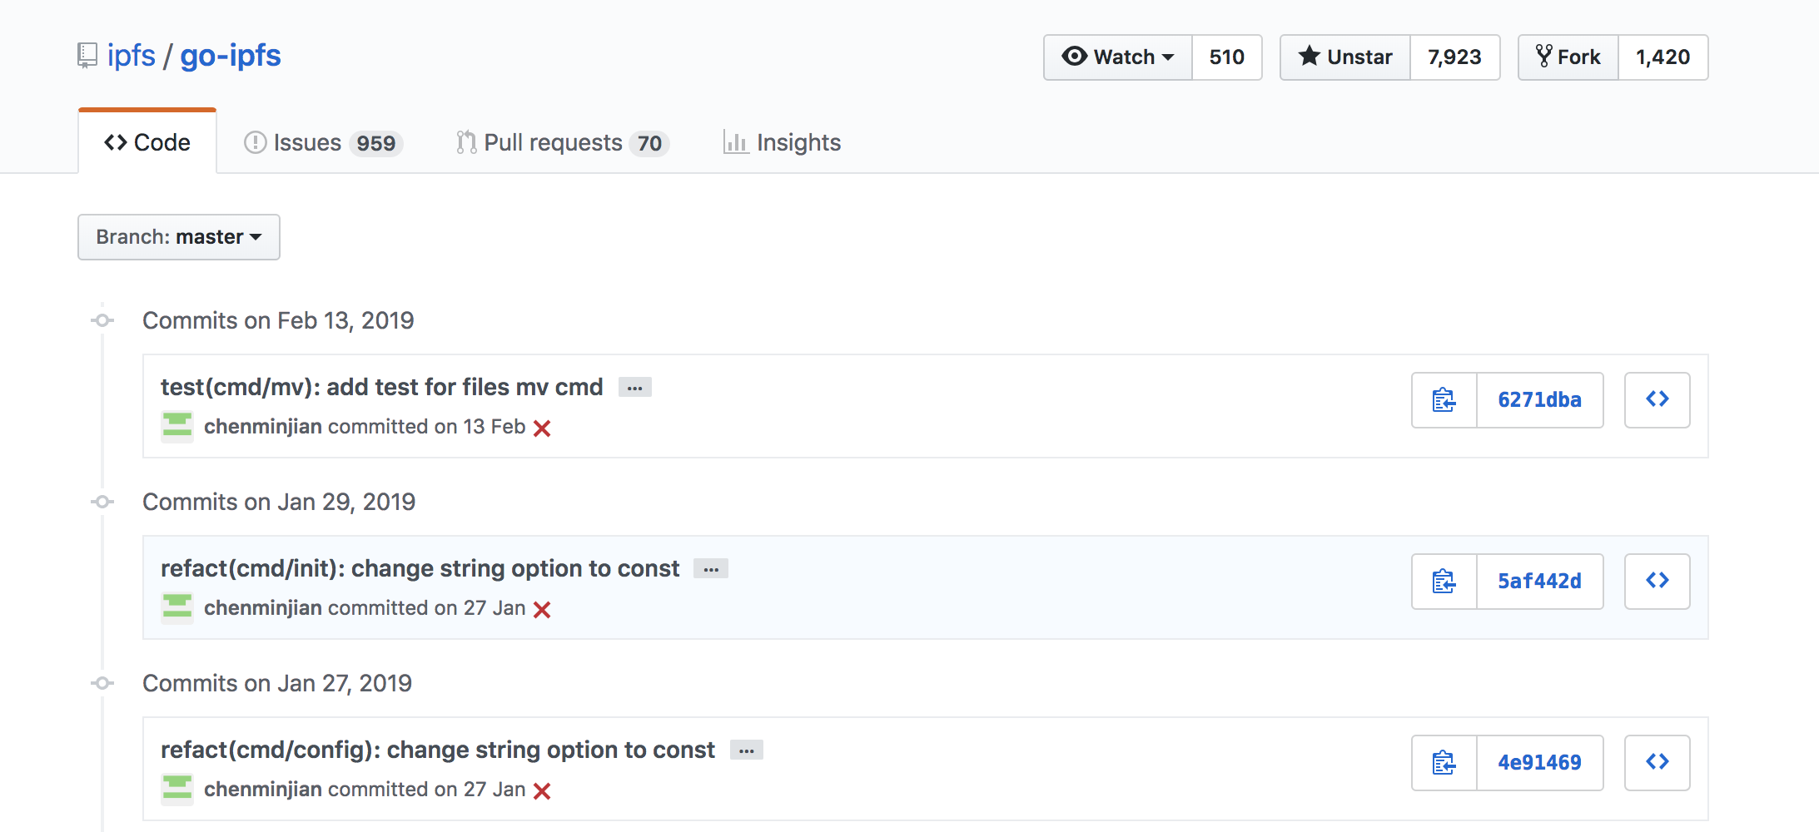
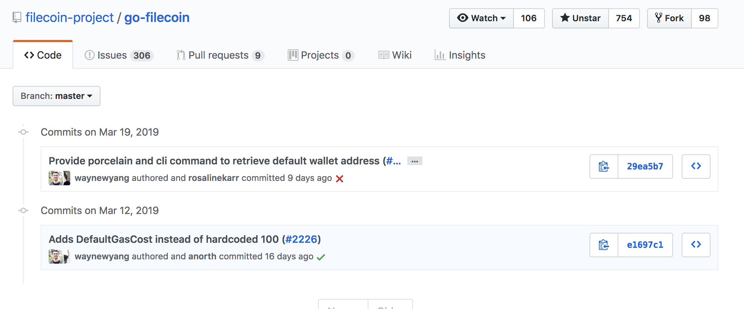
Open Source Code Or Solution Contributions
Some of Chinese Independent Developers Contributions

Slide 17
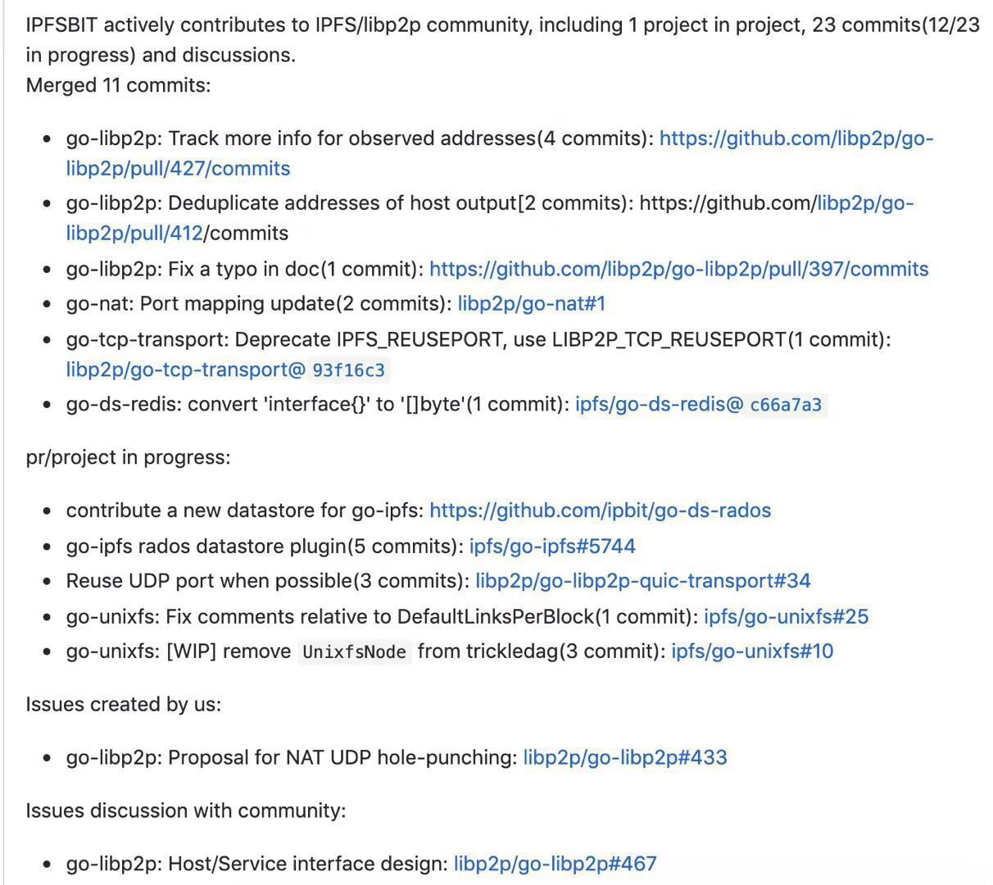
Open Source Code Or Solution Contributions
Some of chinese technology company’s contributions
( Thanks to the contribution list from IPFSBIT.com )

Slide 18
Open Source Code Or Solution Contributions
Some Solutions or Applications With IPFS or Libp2p
IPFS –MD-WIKI：a distribute wiki system with ipfs and markdown
Maze : an end to end encryption network box with libp2p
The Angel： a donation platform with IPFS and EOS

Slide 19


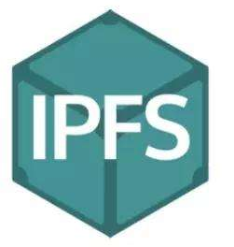


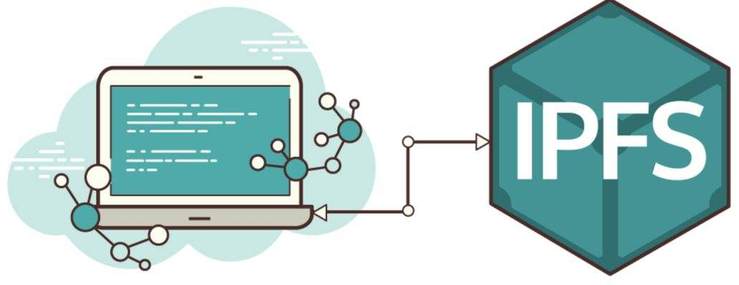
Open Source Code Or Solution Contributions
IPFS –MD-WIKI：a distribute wiki system with ipfs and markdown
User1
User2
User3
Editor1
HTTP Gateway / IPFS
User4
User5
Editor2
……
……

Slide 20
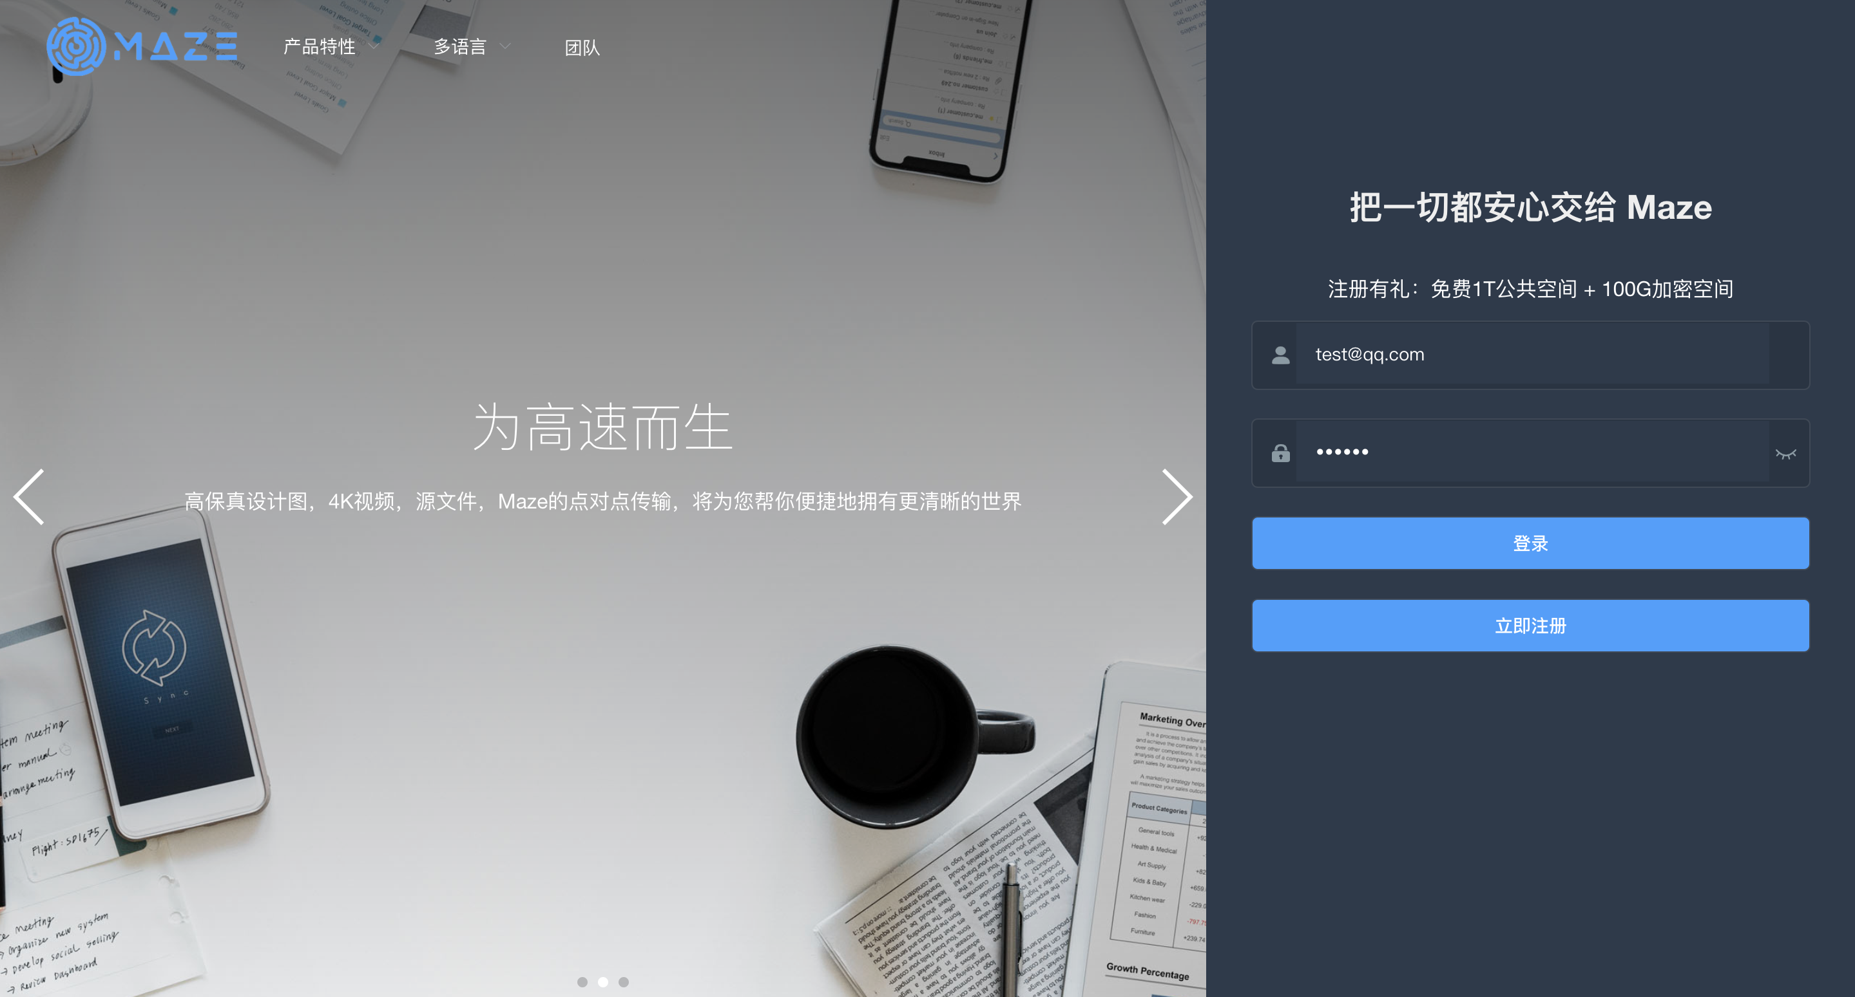
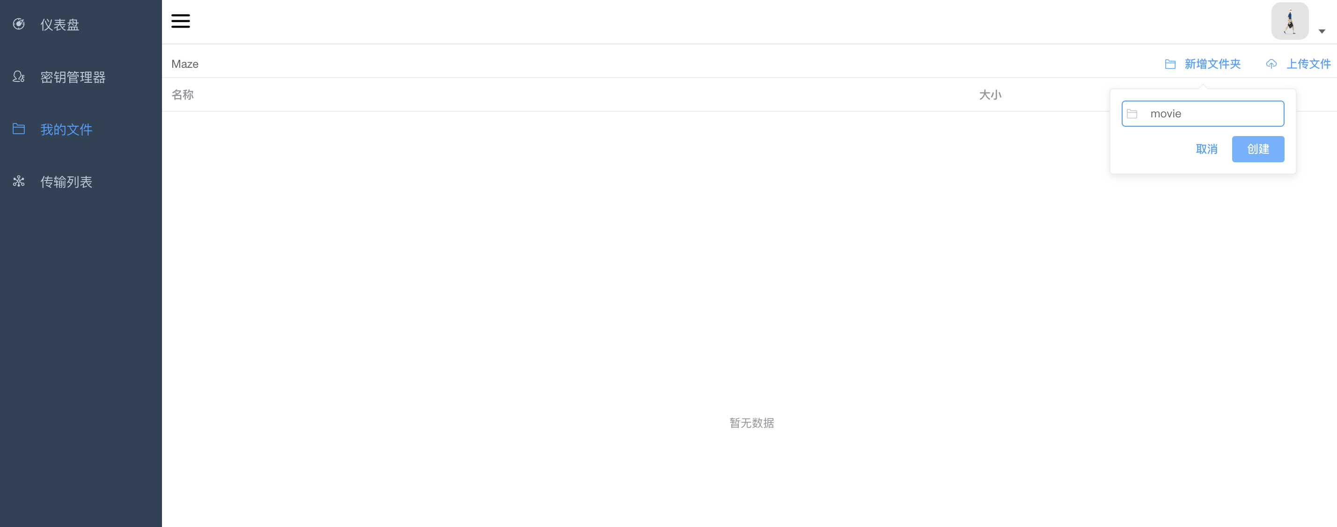
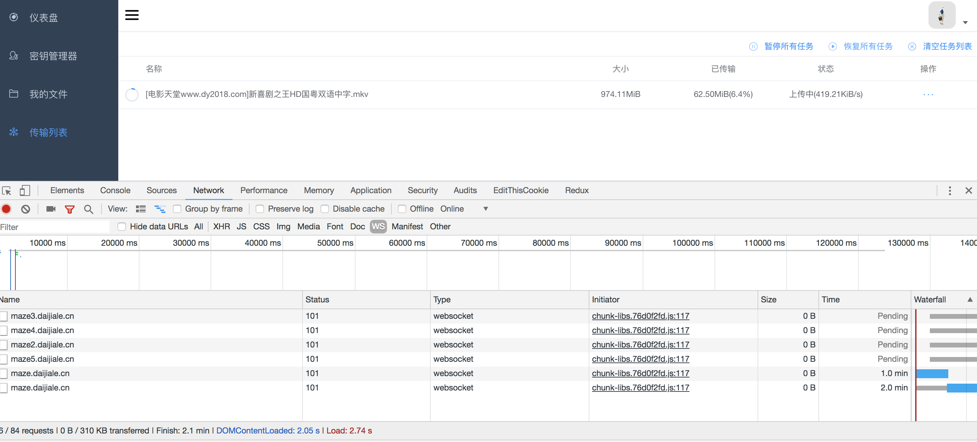
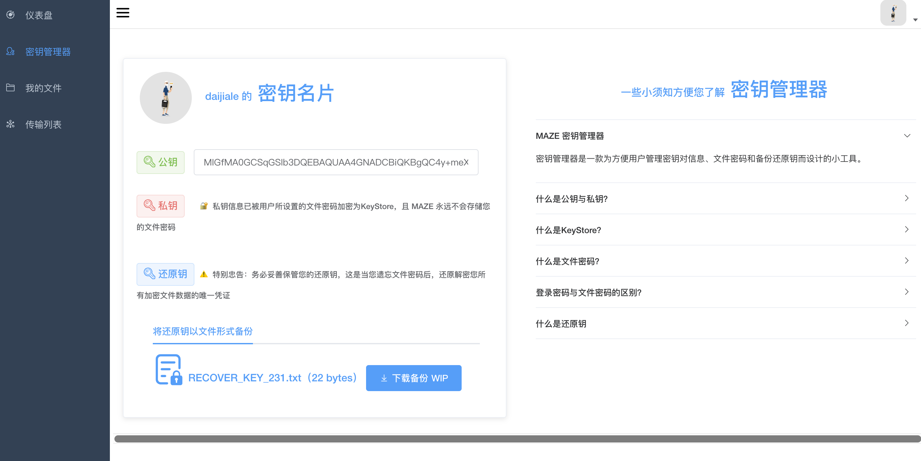
Open Source Code Or Solution Contributions
Maze : an end to end encryption network box with libp2p

Slide 21
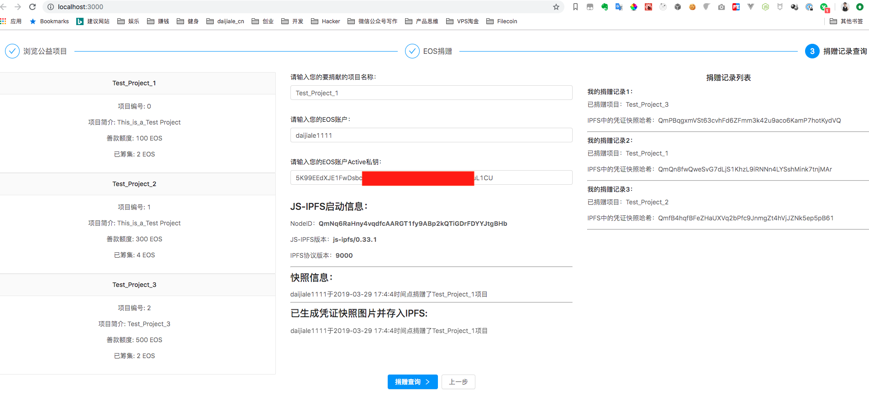
Open Source Code Or Solution Contributions
The Angel： a donation platform with IPFS and EOS

Slide 22
5. My Advices About IPFS or Filecoin Development In China
The Key : If we can find out more befitting business models for those chinese companies or enthusiasts ?

Slide 23
The Key : If we can find out more befitting business models for those chinese companies or enthusiasts ?
a. Professional Education Bussiness and Official Certificate
b. Hackathon with Protocol lab‘s technologies in China
c. More Official Community Events Is Needed In Chinese

Slide 24
6. Q&A
Thank you

